Slide 1
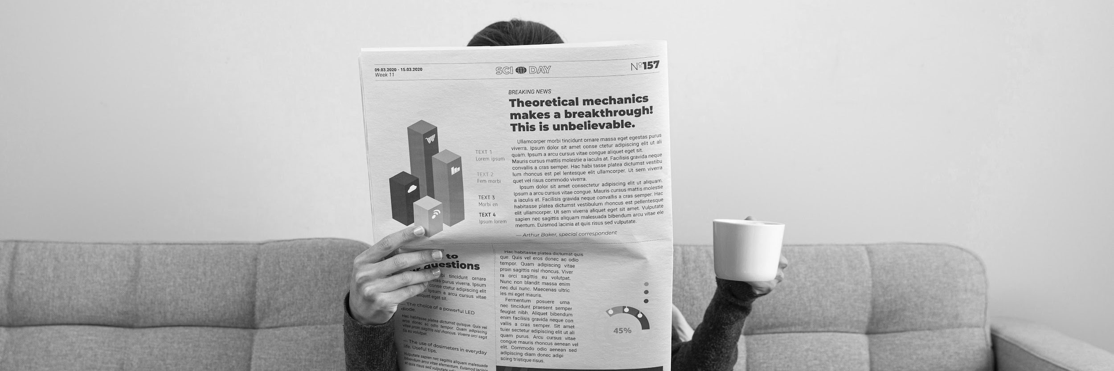
The Daily News Infographics
Friday 08/05/2xxx
Infographics
Edition: 001
“Here is where this template begins”

Slide 2
The daily news infographics
Friday 08/05/2xxx
Infographics
Edition: 001
This template contains an assortment of complementary infographic resources for the The Daily News Newsletter presentation.
These infographics are adapted to the style of the aforementioned presentation, so you can insert them easily and have them completely integrated at once. You just need to do the following:
Select the element that you want to copy
Right-click and choose “Copy”
Go to the slide where you want the element to appear
Right-click and choose “Paste”

Slide 3
The daily news infographics
Venus
Friday 08/05/2xxx
Infographics
Edition: 001
60%
50%
Mars
Venus is the second planet from the Sun
Despite being red, Mars is a cold place
40%
Jupiter
25%
Saturn
It’s the biggest planet in the Solar System
Saturn is a gas giant and has several rings

Slide 4
The daily news infographics
Friday 08/05/2xxx
Infographics
Edition: 001
Mars
Despite being red, Mars is actually a cold place
Venus
Venus is the second planet from the Sun
Jupiter
Jupiter is the biggest planet in the Solar System
Mercury
Mercury is the smallest planet of them all
Neptune
Neptune is the farthest planet from the Sun

Slide 5
The daily news infographics
Venus
Friday 08/05/2xxx
Infographics
Edition: 001
90%
75%
50%
Mars
Jupiter
Venus is the second planet from the Sun
Despite being red, Mars is a cold place
It’s the biggest planet in the Solar System

Slide 6
The daily news infographics
Friday 08/05/2xxx
Infographics
Edition: 001
01
Mercury
04
Saturn
It’s the closest planet to the Sun
It’s composed of hydrogen and helium
Last important news
02
Jupiter
05
Mars
Jupiter is the biggest planet of them all
Mars is actually a very cold place
03
Venus
06
Neptune
Venus is the second planet from the Sun
It’s the farthest planet from the Sun

Slide 7
The daily news infographics
Friday 08/05/2xxx
Infographics
Edition: 001
60%
News 1
Mercury is the closest planet to the Sun
40%
News 2
Despite being red, Mars is a cold place
20%
News 3
Venus is the second planet from the Sun
80%
News 4
Jupiter is the biggest planet of them all

Slide 8
The daily news infographics
Friday 08/05/2xxx
Infographics
Edition: 001
Chris Smith
Dan Do
Jack Robson
“Mercury is the smallest planet”
“Venus is the second planet from the Sun”
“Mars is actually a very cold place”
Dianne Trots
Anne Marie
Zu Cho
“Jupiter is the biggest planet of them all”
“Saturn is a gas giant with several rings”
“Neptune is far away from Earth”

Slide 9
The daily news infographics
Friday 08/05/2xxx
Infographics
Edition: 001
Mercury
It’s the closest planet to the Sun
Jupiter
Jupiter is the biggest planet of them all

Slide 10
The daily news infographics
Friday 08/05/2xxx
Infographics
Edition: 001
Mercury
01
02
Saturn
It’s the closest planet to the Sun
It’s composed of hydrogen and helium
Jupiter
06
03
Mars
Jupiter is the biggest planet of them all
Mars is actually a very cold place
Venus
05
04
Neptune
Venus is the second planet from the Sun
It’s the farthest planet from the Sun

Slide 11
The daily news infographics
News 1
Friday 08/05/2xxx
Infographics
Edition: 001
News 2
News 3
Venus is the second planet from the Sun
Despite being red, Mars is a cold place
Jupiter is the biggest planet of them all
Describe your news here
Describe your news here
Describe your news here
Describe your news here
Describe your news here
Describe your news here
Describe your news here
Describe your news here
Describe your news here
Describe your news here
Describe your news here
Describe your news here

Slide 12
The daily news infographics
Friday 08/05/2xxx
Infographics
Edition: 001
A
B
C
D
Mercury
Jupiter
Venus
Earth
It’s the closest planet to the Sun
It’s the biggest planet of them all
Venus has a very toxic atmosphere
Earth is where we all live together
80%
60%
50%
45%

Slide 13
The daily news infographics
Friday 08/05/2xxx
Infographics
Edition: 001
News summary
Week 1 | Week 2 | Week 3 | Week 4
Mercury is the closest planet to the Sun | Earth is the planet with life | Venus has extremely high temperatures | Mars is full of iron oxide dust
Mars is actually a very cold place | Neptune is the farthest planet from the Sun | The Moon is Earth’s only natural satellite | Jupiter is the biggest planet of them all
Ceres is located in the main asteroid belt | Pluto is considered a dwarf planet | Saturn is not the only planet with rings | Mercury is the smallest planet

Slide 14
The daily news infographics
Friday 08/05/2xxx
Infographics
Edition: 001
A
B
C
News A
News C
Mercury is the smallest planet
Venus has a beautiful name
News B
90%
50%
Jupiter is the biggest planet
75%

Slide 15
The daily news infographics
Friday 08/05/2xxx
Infographics
Edition: 001
Online
Print
Mercury is the smallest planet
Main readers
Jupiter is the biggest planet
60%
40%

Slide 16
The daily news infographics
Friday 08/05/2xxx
Infographics
Edition: 001
Sport news
Men
Women
Earth is the third planet from the Sun and the only one that harbors life in the Solar System. This is where we all live
Mercury is the closest planet to the Sun and the smallest one
Venus has a beautiful name and is the second planet from the Sun
60%
40%
Age of readers
25-35 years
36-45 years

Slide 17

The daily news infographics
Friday 08/05/2xxx
Infographics
Edition: 001
11%
35%
Sports
Sensational
Saturn is a gas giant with several rings
Mercury is the closest planet to the Sun
24%
30%
Business
Politic
Venus is the second planet from the Sun
Despite being red, Mars is actually a cold place
Follow the link in the graph to modify its data and then paste the new one here. For more info, click here

Slide 18
The daily news infographics
Friday 08/05/2xxx
Infographics
Edition: 001
60%
50%
40%
20%
News A
News B
News C
News D
Mercury is the smallest planet
Jupiter is the biggest planet
Venus has a very toxic atmosphere
Earth is the planet where we all live

Slide 19
The daily news infographics
Friday 08/05/2xxx
Infographics
Edition: 001
Print
Online
Mercury is the closest planet to the Sun and the smallest one in the Solar System—it’s only a bit larger than the Moon
Venus has a beautiful name and is the second planet from the Sun. It’s hot and has a poisonous atmosphere
137 million
145 million
A week
A day

Slide 20
The daily news infographics
Friday 08/05/2xxx
Infographics
Edition: 001
Big news
Business
Local news
Despite being red, Mars is a cold place
Earth is the third planet from the Sun
World news
Death notices
Weather
Venus is the second planet from the Sun
Mercury is the smallest planet
Saturn is a gas giant with rings

Slide 21
The daily news infographics
Friday 08/05/2xxx
Infographics
Edition: 001
Soft news
Venus has a beautiful name and is the second planet from the Sun. It’s terribly hot, even hotter than Mercury, and its atmosphere is extremely poisonous
Sports |  | Celebrity gossip
Entertainment |  | Editorial
Food |  | Obituary
Travel |  | Horoscopes

Slide 22
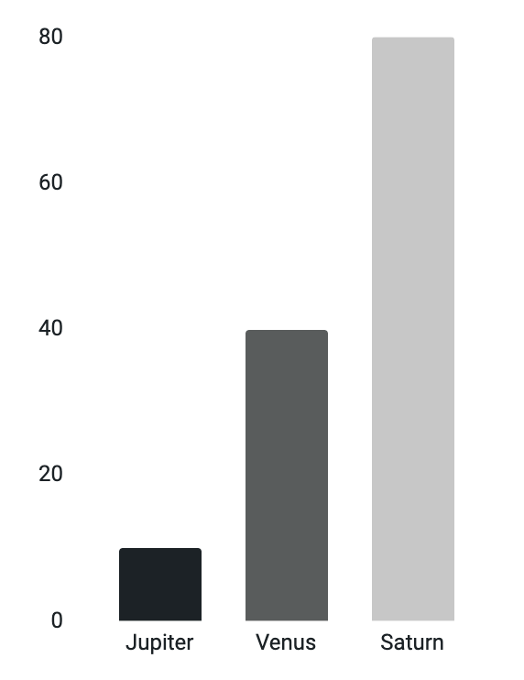
The daily news infographics
Friday 08/05/2xxx
Infographics
Edition: 001
Important information
International news
Venus is the second planet from the Sun
Ceres is located in the main asteroid belt
Jupiter
Mars
Jupiter is big
Despite being red, Mars is actually a cold place, not hot. It’s full of iron oxide dust
Venus
Venus is hot
Earth is where we all live
Saturn
Saturn has rings
Follow the link in the graph to modify its data and then paste the new one here. For more info, click here

Slide 23
The daily news infographics
Friday 08/05/2xxx
Infographics
Edition: 001
Business
Politics
Mercury is the smallest planet
Mars is actually a very cold place
11 am
1 pm
3 pm
6 pm
9 pm
Weather
Celebrity
Horoscope
Jupiter is the biggest planet
Earth is where we all live together
Neptune is far away from Earth

Slide 24
The daily news infographics
News A
News B
Friday 08/05/2xxx
Infographics
Edition: 001
Venus has a very beautiful name
Jupiter is the biggest planet of them all
Describe your news here
Describe your news here
Describe your news here
Describe your news here
Describe your news here
Describe your news here
Describe your news here
Describe your news here
75%
25%
News A
News B
Mercury is the smallest planet
Saturn is a gas giant with rings

Slide 25
The daily news infographics
Friday 08/05/2xxx
Infographics
Edition: 001
Mercury
Mars
It’s the closest planet to the Sun
Mars is actually a very cold place
Earth
Earth is the third planet from the Sun
Jupiter
Neptune
It’s the biggest planet of them all
It’s the farthest planet from the Sun

Slide 26
The daily news infographics
Friday 08/05/2xxx
Infographics
Edition: 001
 | News 1 | News 2 | News 3 | News 4 | News 5 | News 6
9-10 am | Politics
10-11 am |  | Police
11-12 pm |  |  | Weather
12-1 pm |  |  |  | Sport
1-2 pm |  |  |  |  |  | Travel
2-3 pm |  |  |  |  |  | Food

Slide 27
The daily news infographics
Venus
Friday 08/05/2xxx
Infographics
Edition: 001
Saturn
Venus is the second planet from the Sun
It’s composed of hydrogen and helium
Jupiter
Mercury
It’s the biggest planet in the Solar System
It’s the closest planet to the Sun
Mars
Neptune
Despite being red, Mars is a cold place
It’s the farthest planet from the Sun

Slide 28
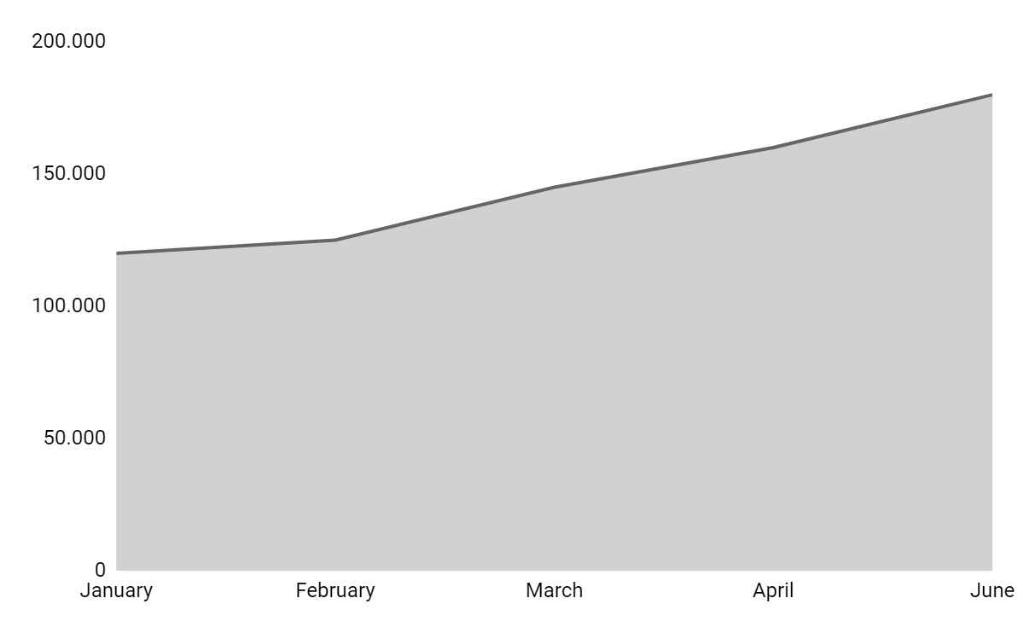
The daily news infographics
Friday 08/05/2xxx
Infographics
Edition: 001
Trend
$180,000
Despite being red, Mars is actually a cold place, not hot. It’s full of iron oxide dust
Follow the link in the graph to modify its data and then paste the new one here. For more info, click here

Slide 29
The daily news infographics
Friday 08/05/2xxx
Infographics
Edition: 001
Mercury
Venus
Mercury is the closest planet to the Sun
Venus is the second planet from the Sun
50%
60%
20%
Jupiter
40%
Mars
Jupiter is the biggest planet of them all
Mars is actually a very cold place, not hot

Slide 30
The daily news infographics
Venus
455,000
Friday 08/05/2xxx
Infographics
Edition: 001
A
Venus is the second planet from the Sun
B
Jupiter
Jupiter is the biggest planet in the Solar System
320,000
C
Mars
Despite being red, Mars is a cold place
180,000

Slide 31
The daily news infographics
Friday 08/05/2xxx
Infographics
Edition: 001
Daily schedule
Hour | Topic | News
8-10 am | Weather | Jupiter is the biggest planet of them all
10-12 am | Business | Mercury is the closest planet to the Sun
12-2 pm | Celebrity | Earth is where we all live together
2-4 pm | Entertainment | Mars is actually a very cold place
4-6 pm | Politics | Neptune is far away from Earth

Slide 32
Instructions for use
If you have a free account, in order to use this template, you must credit Slidesgo in your final presentation. Please refer to the next slide to read the instructions for premium users.
As a Free user, you are allowed to:
- Modify this template.
- Use it for both personal and commercial projects.
You are not allowed to:
- Sublicense, sell or rent any of Slidesgo Content (or a modified version of Slidesgo Content).
- Distribute Slidesgo Content unless it has been expressly authorized by Slidesgo.
- Include Slidesgo Content in an online or offline database or file.
- Offer Slidesgo templates (or modified versions of Slidesgo templates) for download.
- Acquire the copyright of Slidesgo Content.
For more information about editing slides, please read our FAQs or visit Slidesgo School:
https://slidesgo.com/faqs and https://slidesgo.com/slidesgo-school

Slide 33
Instructions for use (premium users)
As a Premium user, you can use this template without attributing Slidesgo.
You are allowed to:
Modify this template.
Use it for both personal and commercial purposes.
Hide or delete the “Thanks” slide and the mention to Slidesgo in the credits.
Share this template in an editable format with people who are not part of your team.
You are not allowed to:
Sublicense, sell or rent this Slidesgo Template (or a modified version of this Slidesgo Template).
Distribute this Slidesgo Template (or a modified version of this Slidesgo Template) or include it in a database or in any other product or service that offers downloadable images, icons or presentations that may be subject to distribution or resale.
Use any of the elements that are part of this Slidesgo Template in an isolated and separated way from this Template.
Register any of the elements that are part of this template as a trademark or logo, or register it as a work in an intellectual property registry or similar.
For more information about editing slides, please read our FAQs or visit Slidesgo School:
https://slidesgo.com/faqs and https://slidesgo.com/slidesgo-school

Slide 34
Infographics
You can add and edit some infographics to your presentation to present your data in a visual way.
Choose your favourite infographic and insert it in your presentation using Ctrl C + Ctrl V or Cmd C + Cmd V in Mac.
Select one of the parts and ungroup it by right-clicking and choosing “Ungroup”.
Change the color by clicking on the paint bucket.
Then resize the element by clicking and dragging one of the square-shaped points of its bounding box (the cursor should look like a double-headed arrow). Remember to hold Shift while dragging to keep the proportions.
Group the elements again by selecting them, right-clicking and choosing “Group”.
Repeat the steps above with the other parts and when you’re done editing, copy the end result and paste it into your presentation.
Remember to choose the “Keep source formatting” option so that it keeps the design. For more info, please visit Slidesgo School.

